Slide 1
Variants of for -loop
Variation 1 ( for using comma(,) operator)
This includes the comma operator in initialization or updation section
Example:
for(i=0, j=0; i+j < 10; i++,j++) //includes comma operator
{
}
Here, both x and y control the loop.

Slide 2
Variation 1- for loop (using , operator)
Write a C program to use , operator in for loop
#include<stdio.h>
int main()
{
int x,y;
for(x=0,y=0; x+y<10; x++,y++)
printf("x=%d\n", x);
return 0;
}
Notes:
Title + Image + Text

Slide 3
Variation 1- for loop (using , operator)
Write a C program to print the following using for-loop
output
The value of i =0 and j=10
The value of i =1 and j=9
Notes:
Title + Image + Text

Slide 4
Variation 1- for loop (using , operator)
Write a C program to use , operator in for loop
#include <stdio.h>
int main()
{
int i, j;
for (i = 0, j = 10; i < 3 && j > 8; i++, j--){
printf (" the value of i = %d and j %d\n",i, j);
}
}
Notes:
Title + Image + Text

Slide 5
Variation 2 (for- without updating section
This includes the missing pieces of the loop definition.
For example,
for(x=0; x!=456; ) //missing updating section
scanf ("%d", &x);
Here, when each time the loop repeats, x is tested to check if it equals 456.
The loop conditions become false and terminates the loop, when 456 is entered.

Slide 6
Variation 2 (for- without updating section)
Write a C program to use for loop without updation section
#include<stdio.h>
int main()
{
int x;
for(x=0; x!=456;)
scanf("%d",&x);
return 0;
}

Slide 7
Variation 3 (missing body)
This includes for Loop with No Body.
The body of the for loop may also be empty. This improves the efficiency of some code.
For example,
application of a loop is a Time delay with an empty body, as shown in an example given below −
for (t=0; t<1000; t++);

Slide 8
Infinite loops:
An infinite loop is a looping construct that does not terminate the loop and executes the loop forever.
It is also called an indefinite loop or an endless loop
Infinite for loop
Syntax:
for( ; ; )
{
//body of the loop
}

Slide 9
Infinite loops:
//infinite for loop
#include <stdio.h>
int main()
{
for(;;)
{
printf(“naveen\n");
}
return 0;
}
“naveen" will be displayed infinitely.

Slide 10
Infinite loops:
Infinite while loop
Syntax:
while(1)
{
//body of the loop
}

Slide 11
Infinite loops:
//infinite while loop
#include <stdio.h>
int main()
{
int i=0;
while(1)
{
i++;
printf("i is :%d",i);
}
return 0;
}

Slide 12
Jump Statements/ branching statements
Jump Statement makes the control jump to another section of the program unconditionally when encountered.
Used to terminate the loop or switch-case instantly.
Used to escape the execution of a section of the program.
break
continue
goto
Notes:
We will see return in later lesson

Slide 13
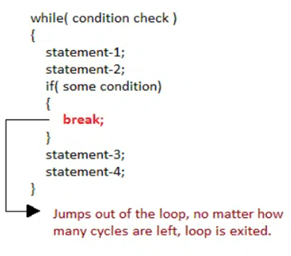
Control with break and continue
A break statement is used to terminate the execution of the rest of the block where it is present and takes the control out of the block to the next statement.
To terminate the loop or switch block
Syntax:
break;
Notes:
As soon as the break statement is encountered from within a loop, the loop iterations stops there and control returns from the loop immediately to the first statement after the loop.

Slide 14
Write a C program to break for loop when for 5th iteration of loop statement.
output:
0 1 2 3 4 5 came outside of loop i = 5
Notes:
As soon as the break statement is encountered from within a loop, the loop iterations stops there and control returns from the loop immediately to the first statement after the loop.

Slide 15
Write a C program to break for loop when for 5th iteration of loop statement.
#include<stdio.h>
#include<stdlib.h>
void main ()
{
int i;
for(i = 0; i<10; i++)
{
printf("%d ",i);
if(i == 5)
break;
}
printf("came outside of loop i = %d",i);
}

Slide 16
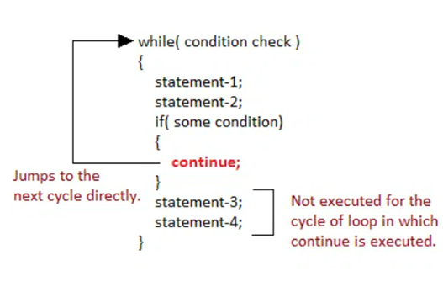
continue Statement
To execute the next iteration of the loop.
Syntax:
//loops stmts
continue;
//stmts to be skipped

Slide 17
Write a C program to continue for loop when for 5th iteration of loop statement.
//program on continue
#include<stdio.h>
int main()
{
int i=1;//initializing a local variable
//starting a loop from 1 to 10
for(i=1;i<=10;i++){
if(i==5) // it will continue for next iteration
{
continue;
}
printf("%d \n",i);
}//end of for loop
return 0;
}

Slide 18
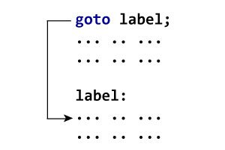
goto Statement
The goto statement allows us to transfer control of the program to the specified label.
Syntax:
label:
//some part of the code;
goto label;

Slide 19
goto Statement
Parts of goto statement
goto is divided in two parts, label definition and goto keyword.
Label
“Label” is a valid C identifier followed by colon symbol :
Label specifies control transfer location.
Each label work as a bookmark to specific location. You are free to define any number of labels anywhere inside a function.
goto:
“goto” is a keyword used along with label name to transfer program control to the mentioned label.
You can only transfer program control to a label within same function.

Slide 20
WAP to calculate the sum and average of positive numbers
// If the user enters a negative number, the sum and average are displayed.
#include <stdio.h>
int main() {
const int maxInput = 100;
int i;
double number, average, sum = 0.0;
for (i = 1; i <= maxInput; ++i) {
printf("%d. Enter a number: ", i);
scanf("%lf", &number);
/ go to jump if the user enters a negative number
if (number < 0.0) {
goto jump;
}
sum =sum+ number;
}
jump:
average = sum / (i - 1);
printf("Sum = %.2f\n", sum);
printf("Average = %.2f", average);
return 0;
}

